Slide 1
CLOUD LOGGING SINK TO BIGQUERY FOR LOG ANALYTICS
Skill Project
Submitted by
1.D. Gnana Prasanna Maruthi — 2400039070
2. V. Sudheer — 2400039069
3. Sk. Abdul Habeeb — 2400039068
4. K. Srilakshmi — 2400039067

Slide 2
Introduction
Cloud Logging is a Google Cloud service.
It collects logs from applications and cloud services.
Logs contain information, warnings, and errors.
A Logging Sink sends selected logs to BigQuery.
BigQuery helps us analyze data using SQL queries.
Charts and graphs help us understand the results.
Example: A successful login is recorded as INFO, and a failed payment is recorded as ERROR.

Slide 3
Project Objective
To understand how Cloud Logging collects application logs.
To configure a Logging Sink to route logs to BigQuery.
To learn how SQL queries can analyze data.
To understand how log data helps identify application errors.
To learn how charts and graphs present log analysis results.

Slide 4
System Architecture
Cloud Logging: Collects application and cloud service logs.
Log Router: Processes log entries and routes matching logs.
Logging Sink: Defines the destination for the selected logs.
BigQuery: Stores and analyzes exported log data.
SQL Analysis: Helps identify patterns and errors.
Visualization: Presents analysis results using charts and graphs.

Slide 5
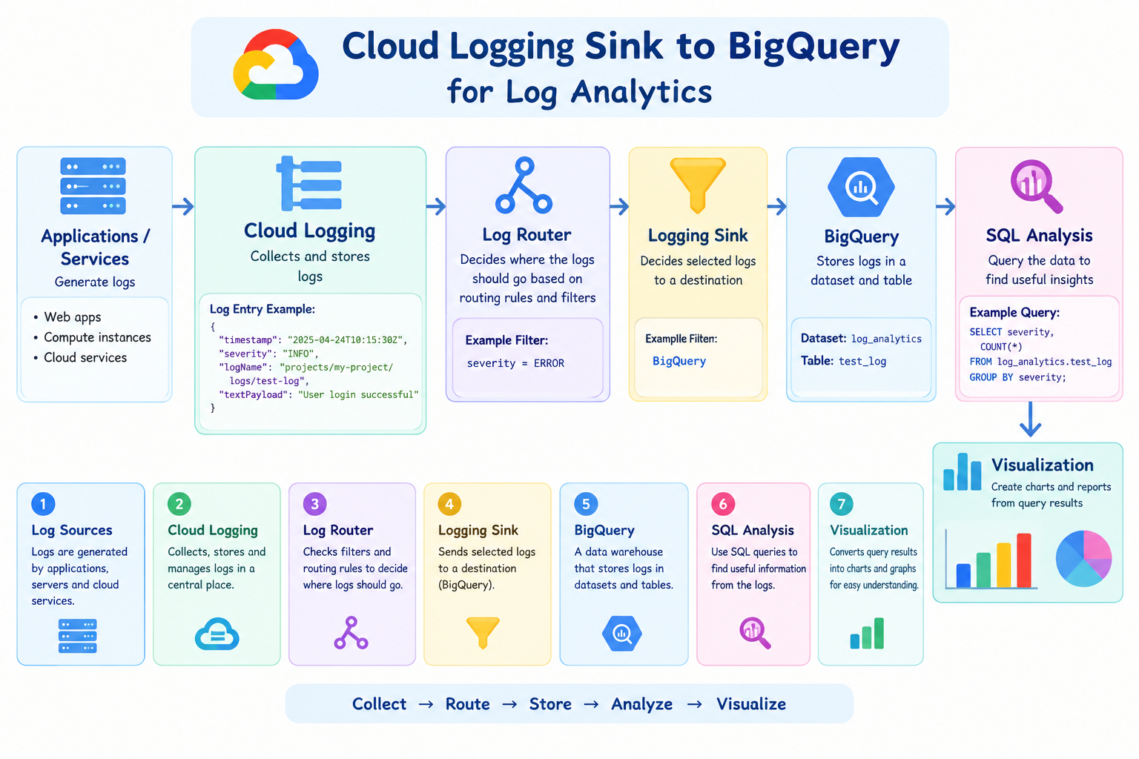

Slide 6
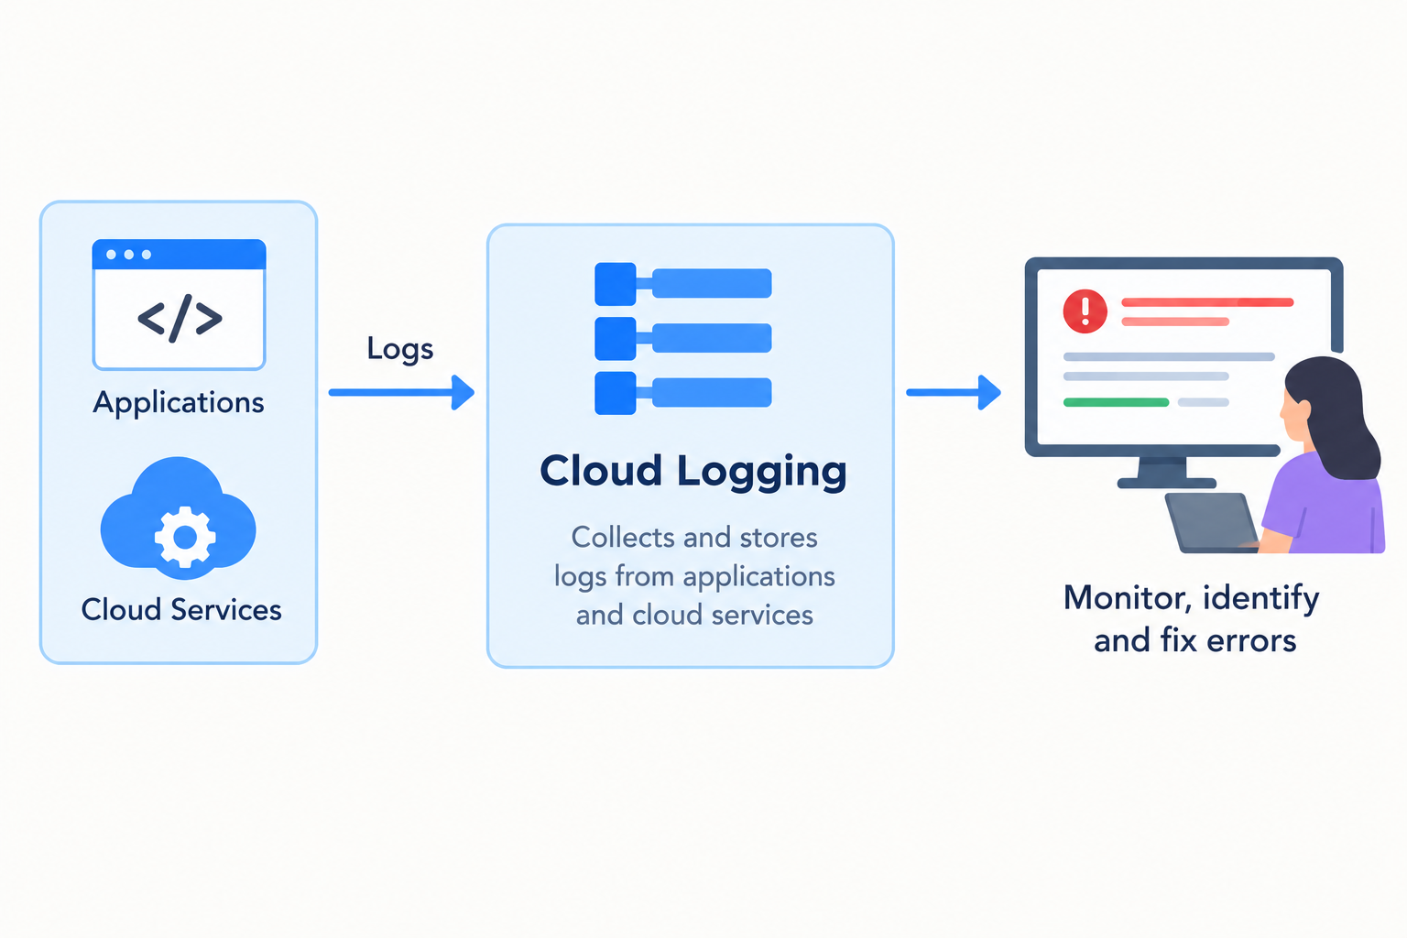
Cloud Logging
Cloud Logging is a Google Cloud service that collects and stores logs from applications and cloud services.
It helps developers monitor application activities and identify errors.
Example: If a user fails to log in, Cloud Logging records the error to help the developer find the problem.

Slide 7
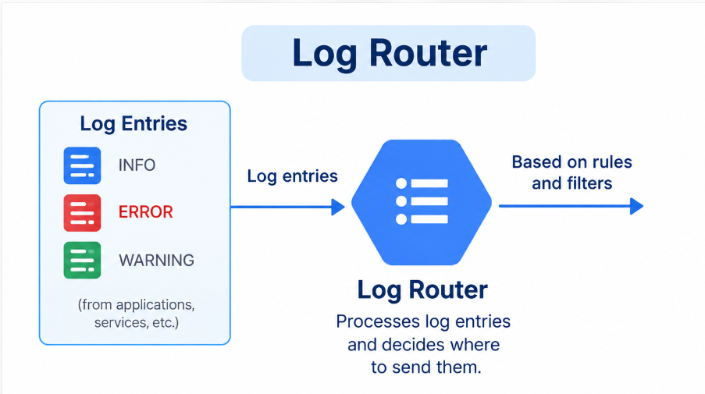
Log Router
Log Router processes log entries in Cloud Logging and decides where to send them.
It uses routing rules and filters to direct logs to the correct destination.
Example: The Log Router identifies an application's ERROR logs and routes them to a Logging Sink, which sends them to BigQuery for analysis.

Slide 8
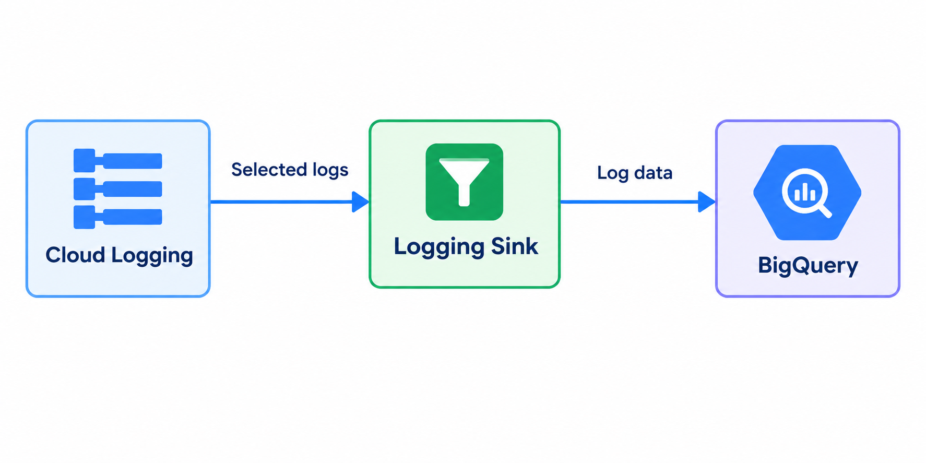
Logging Sink
A Logging Sink sends selected logs from Cloud Logging to another service.
In our project, it sends log data to BigQuery for analysis.
Example: If an application records an error when a user logs in, the Logging Sink can send that error log to BigQuery for analysis.

Slide 9
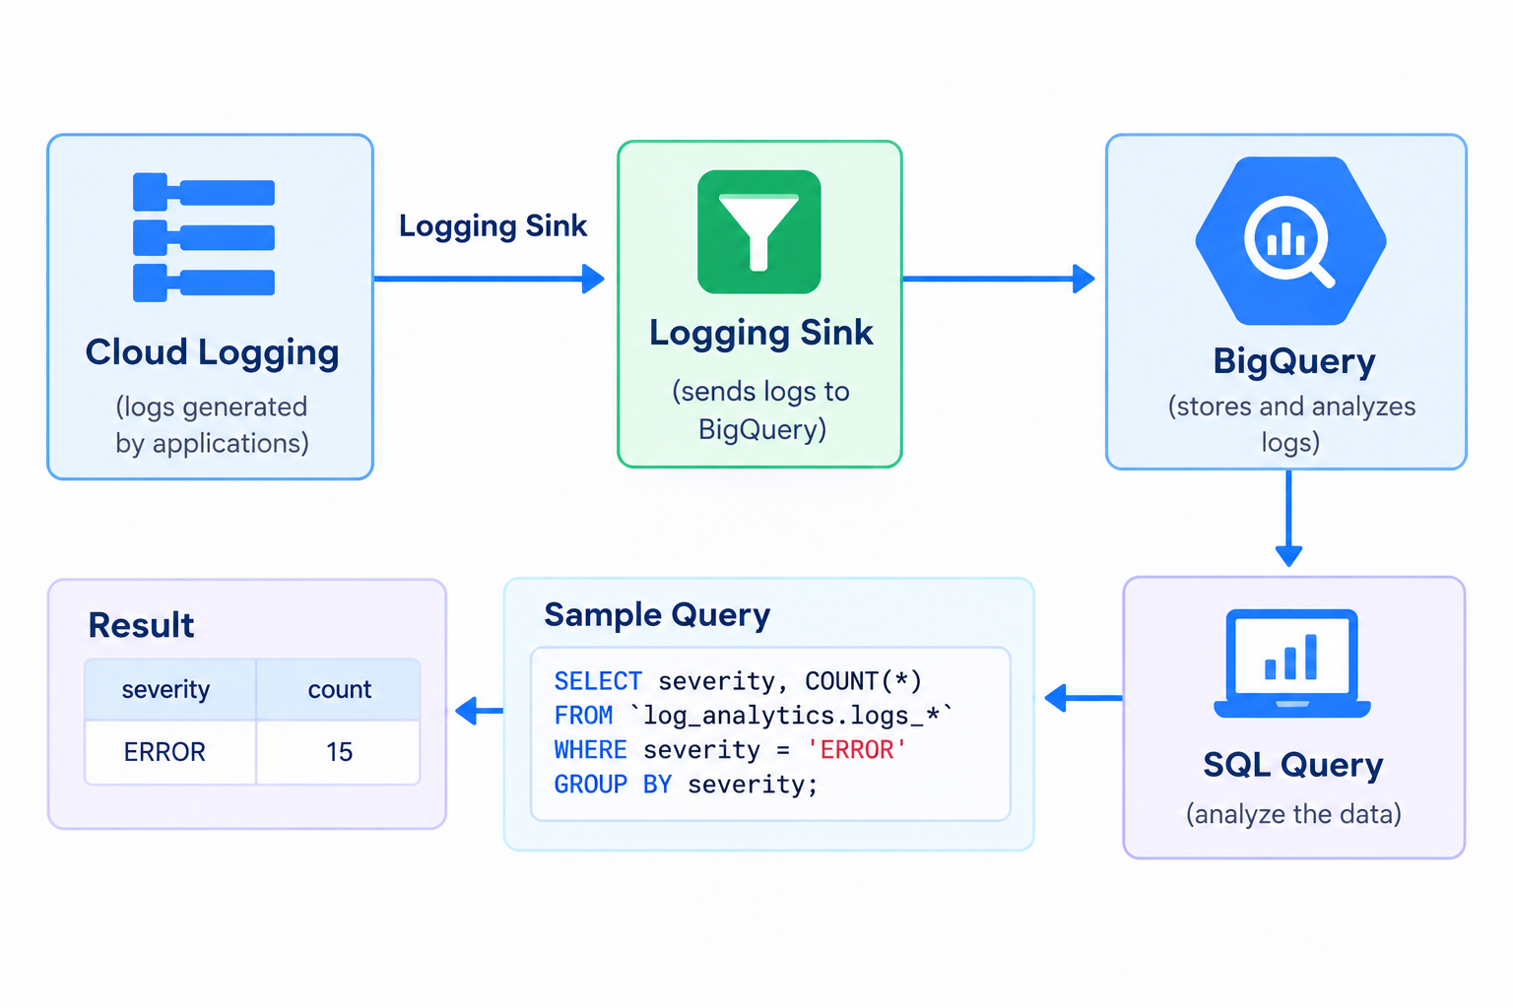
BigQuery
BigQuery is a Google Cloud service used to store and analyze data.
In our project, we created a dataset named log_analytics.
We configured a Logging Sink to send logs to BigQuery.
We used SQL queries to practice analyzing sample data.
Example: Counting errors using an SQL query.

Slide 10
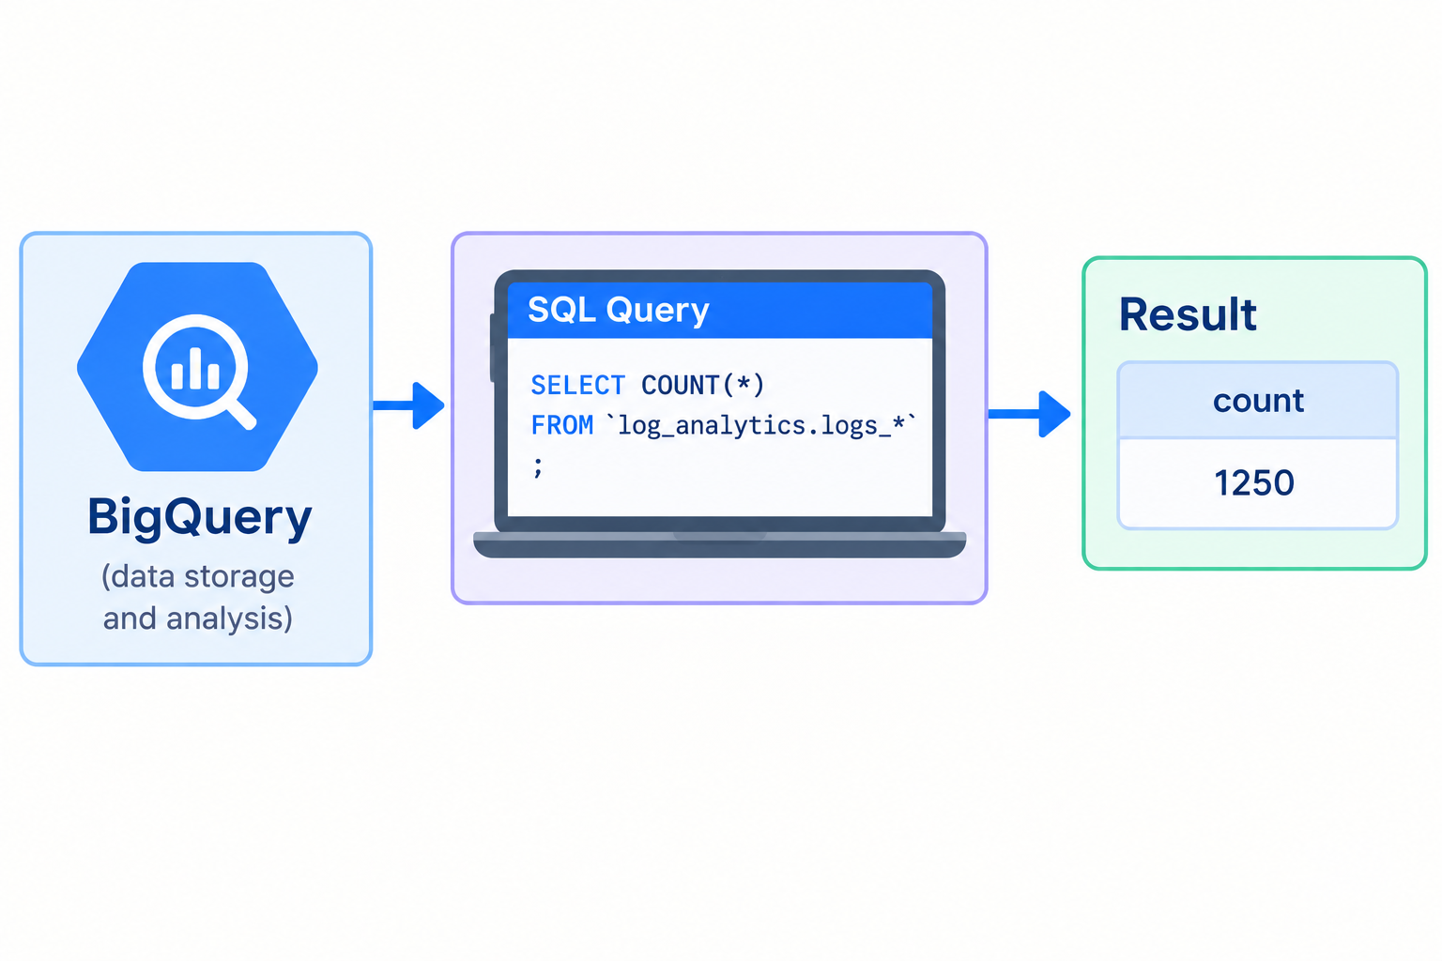
SQL Analysis
SQL helps us search and analyze data in BigQuery.
We used SQL queries to practice analyzing sample data.
It helps us find useful information from the data.
Example: Counting the number of records using an SQL query.

Slide 11
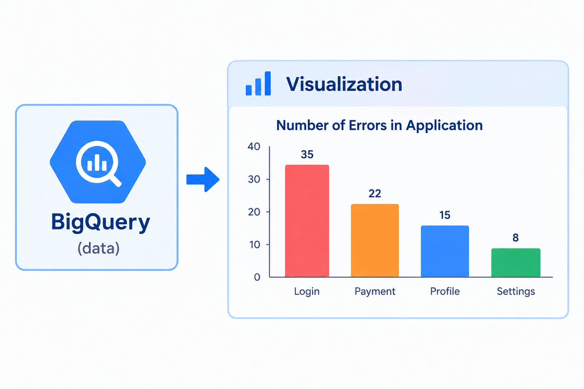
Data Visualization
Visualization shows data in the form of charts and graphs.
It helps us understand the analysis results easily.
We can use charts to present useful information from the data.
Example: A bar chart showing the number of errors in an application.

Slide 12
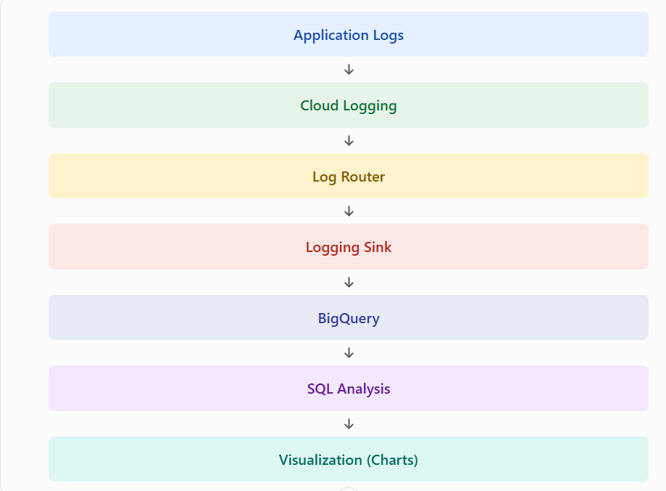
Workflow

Slide 13
Expected Outcome
Understand how Cloud Logging collects application logs.
Learn how a Logging Sink routes selected logs to BigQuery.
Practice analyzing sample data using SQL queries.
Understand how log data can help identify application errors.
Learn how data analysis results can be presented using charts.

Slide 14
Conclusion
We learned how Cloud Logging collects application logs.
We understood how a Logging Sink sends selected logs to BigQuery.
We practiced using SQL queries to analyze sample data.
This project helps us understand how cloud logs can be analyzed to identify useful information.
Future Scope: We can enable billing and verify the actual export of logs to BigQuery.

Slide 15
Thank You

